Slide 1
Chapter Six
Networking Fundamentals
Notes:
A network links 2 or more computers together to communicate and share resources.
Think of a human network and what we share with our networks - families, friends, schoolmates, coworkers etc.
In many cases, networking today has become a relatively simple plug-and-play process. Wireless network cards can automatically detect and join networks, and then you’re seconds away from surfing the Web or sending email
There is a lot of background information you should understand about how networks
work. The following sections cover the fundamentals, and armed with this information you can then move on to how to make it work right

Slide 2


220-901 Objectives Covered
2.1 Identify the various types of network cables and connectors.
  Fiber
    Connectors: SC, ST and LC
  Twisted Pair
    Connectors: RJ-11, RJ-45
    Wiring standards: T568A, T568B
  Coaxial
    Connectors: BNC, F-connector
2.2 Compare and contrast the characteristics of connectors and cabling.
  Fiber
    Types (single-mode vs. multi-mode)
    Speed and transmission limitations
  Twisted pair
    Types: STP, UTP, CAT3, CAT5, CAT5e, CAT6, CAT7, plenum, PVC
    Speed and transmission limitations
    Splitters and effects on signal quality
  Coaxial
    Types: RG-6, RG-59
    Speed and transmission limitations
    Splitters and effects on signal quality

Slide 3
220-901 Objectives Covered (continued)
2.7 Compare and contrast Internet connection types, network types, and their features.
  Network types
    LAN
    WAN
    PAN
    MAN
2.8 Compare and contrast network architecture devices, their functions, and features.
  Hub
  Switch
  Router
  Access point
  Bridge
  Modem
  Firewall
  Patch panel
  Repeaters/extenders
  Ethernet over Power
  Power over Ethernet injector

Slide 4

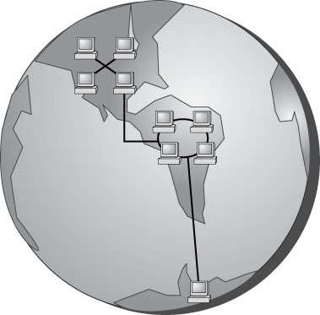
Network Types
LAN
WAN
PAN
MAN
Notes:
Local Area Network – connects computers in a single office or building or homes
Wide Area Network – connects multiple LANs, i.e networks outside the local environment.
Historically, only larger corporations used WANs, but many smaller companies with
remote locations now use them as well.
Personal area network (PAN) is a very small-scale network designed around one person within a very limited boundary area. The term generally refers to networks that use Bluetooth technology.
Metropolitan area network (MAN), which is bigger than a LAN but not quite as big as a WAN.

Slide 5
Network Types
LAN
WAN
PAN
MAN
Notes:
LAN
Local Area Network – connects computers in a single office or building or homes
Centralized processing in older mainframes (all programs ran on the
same computer), the minicomputer used distributed processing to access programs across other computers.
1970s - Minicomputers – their front end perform data entry and minor processing while the back end (servers) did storage and major processing
1980s - Portable computers – did not share information and resources, hence LANs were created.
Initial LANs were rudimentary - The first software programs that ran on a LAN were not capable of being used by more than one user at a time (this constraint was known as file locking).

Slide 6
Network Types
LAN
WAN
PAN
MAN
Notes:
WAN
Late 1980s – networks expanded to cover large geographical areas, supporting thousands of users.
From across states to across countries and continents.
PANs
Bluetooth networks – Bluetooth Special Interest Group (SIG)
Harold Bluetooth – 20th century Danish King
IEEE 802.15.1 – wireless PAN based on Bluetooth includes Mobile devices, keyboards, mice, printers, headsets
Piconet – dynamically created network. Bluetooth is temporary in nature and have no central communication point such as an access point
Bluetooth-enabled device can connect up to 7 devices
Scatternet – 2 or more piconets linked together

Slide 7
Network Types
LAN
WAN
PAN
MAN
Notes:
MAN
Larger than LAN spanning a small geographical area – city or large campus
MAN/WAN difference:
In a MAN, a central IT organization such as the campus or city IT staff is responsible.
In a WAN, it’s implied that you will be using publicly available communication lines and there will be a phone company or other service provider involved

Slide 8
Network Types
LAN
WAN
PAN
MAN
Notes:
Local Area Network – connects computers in a single office or building or homes
Wide Area Network – connects multiple LANs, i.e networks outside the local environment.
Historically, only larger corporations used WANs, but many smaller companies with
remote locations now use them as well.
Personal area network (PAN) is a very small-scale network designed around one person within a very limited boundary area. The term generally refers to networks that use Bluetooth technology.
Metropolitan area network (MAN), which is bigger than a LAN but not quite as big as a WAN.

Slide 9
Network Components
Servers
  Dedicated
  Non-dedicated
Clients or workstations
Resources
  Printers, peripherals, disk storage and file access, applications
Notes:
2 or more computers connected constitutes a network
When you’re looking at the devices or resources available on a network, there are three types of components of which you should be aware:
Servers Clients/Workstations Resources
Servers – core component of a network linking computers with resources/enabler
Servers can perform several different critical roles on a network – file servers, print servers, email servers, remote access servers, administration, authentication servers like DHCP.
Dedicated server is assigned to provide specific applications or services for the network and nothing else
Nondedicated servers are assigned to provide one or more
network services and local access. A nondedicated server is expected to be slightly
more flexible in its day-to-day use than a dedicated server.

Slide 10
Network Components
Servers
  Dedicated
  Non-dedicated
Clients or workstations
Resources
  Printers, peripherals, disk storage and file access, applications
Notes:
Workstations/Clients
Are the computers on which the network users do their work, performing
activities such as word processing, database design, graphic design, email, and other office or personal tasks
In network terms, workstations are also known as client computers. As clients, they are allowed to communicate with the servers in the network to use the network’s resources. Have NICs
To users, being on a network changes a few things:
■■ They can store more information because they can store data on other computers on the network.
■■ They can share and receive information from other users, perhaps even collaborating on the same document
■■ They can use programs that would be too large or complex for their computer to use
by itself.
■■ They can use hardware not attached directly to their computer, such as a printer.

Slide 11
Network Components
Servers
  Dedicated
  Non-dedicated
Clients or workstations
Resources
  Printers, peripherals, disk storage and file access, applications
Notes:
Network Resources
A resource (as far as the network is concerned) is any item that can be used on a network.
Resources can include a broad range of items, but the following items are among the most important:
■■ Printers and other peripherals
■■ Disk storage and file access
■■ Applications
Network Operating Systems (NOSs)
PCs use a disk operating system that controls the file system and how the applications communicate with the hard disk.
Networks use a network operating system (NOS) to control the communication with resources and the flow of data across the network. E.g. Unix, Linux and Windows Server Series (2008, 2012 etc).

Slide 12
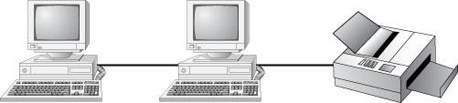
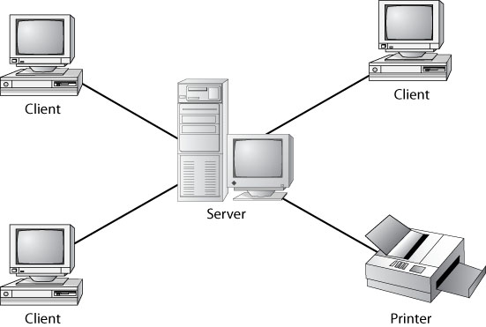
Network Resource Access
Peer-to-peer
Client-server
Notes:
These are 2 models used to access resources. Dependent on:
Size of the organization
Security
Software and hardware resources
Administration – how much, how many levels etc
Cost
Present and future growth
Training needed
Planning is required before a model is chosen

Slide 13
Network Resource Access
Peer-to-peer
Client-server
Notes:
Peer to Peer – aka Workgroups
Computers are both service providers and requestors
Small, simple inexpensive networks. Companies don’t expect future growth.
No centralized administration – every station has unique control of their resources
Therefore difficult to administer and support
If person sharing printer turn s off his system the resource is no longer available
Client-server model – aka server-based model aka Domains
More than 10 computers
Large companies that expect growth – easier to expand the network
One or more dedicated, centralized servers
Better security – server ensures access authentication
Cost more – servers need increased hardware and software (NOS), skilled IT employees
Domain Controller – manages login requests, authentication, password management, resources available to computers.

Slide 14
Network Topologies
Bus
Star
Ring
Mesh
Hybrid
Notes:
A topology is a way of laying out the network
Choice of network requires serious planning and considerations such as:
cost,
ease of installation,
fault tolerance), and
ease of reconfiguration

Slide 15
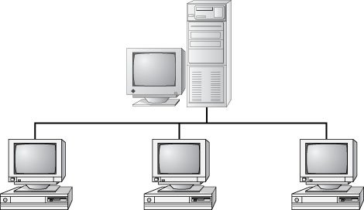
Bus Network
Notes:
Bus topology
Simplest an easiest to install
Single cable that runs to all computers which share the same data and address path
Messages are sent to the same trunk, each computers check if the message is addressed to them. If yes, they receive it if not they ignore it until one accepts it
Lowest cost
Don’t exist today
Disadvantages
Difficult to add a workstation; either reroute the cable or run 2 additional lengths
If cable breaks the entire network is compromised

Slide 16
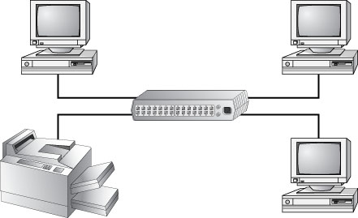
Star Network
Notes:
Star Topology
Each computer branches off a central device like a hub or switch
If hub/switch goes down it affects the whole network (single point of failure)
If computer goes down it doesn’t affect the network (fault tolerant)
Easy to install
More expensive than bus

Slide 17
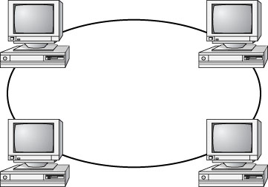
Ring Network
Notes:
Ring Topology
Each computer connects to 2 computers on its left and right (ring)
Messages move from computer to computer – unidirectional
Computers read, regenerate and passes the message
Disadvantages:
Difficult to add new computers
Network will go down if one of the computers (nodes) goes down
Lack fault tolerance
Don’t exist today
Token Ring
Contrary to its name, it does not use a physical ring. It actually uses a
physical star topology, but the traffic flows in a logical ring from one
computer to the next.

Slide 18
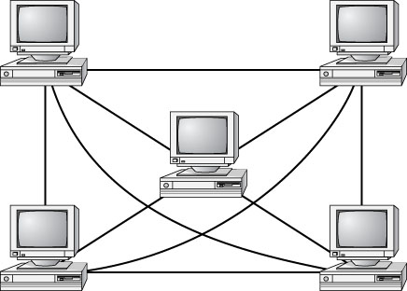
Mesh Network
Notes:
Mesh Topology
Each device is connected to every other device
High fault tolerance – message can take an indirect route if cable fails
Most Complex – rarely found
Number of cables formula = (y X (y-1)) ÷2 Where y is the number of computers
50 computers = (50 X (50-1) ÷2 = 1,225 Cables!!!!!!
Fault tolerance makes it ideal for WAN links – routers are used in this arrangement where each router can search other routers to determine the best path. Under 5 entities is fine, beyond that you have too many connections
Expensive to install and maintain

Slide 19
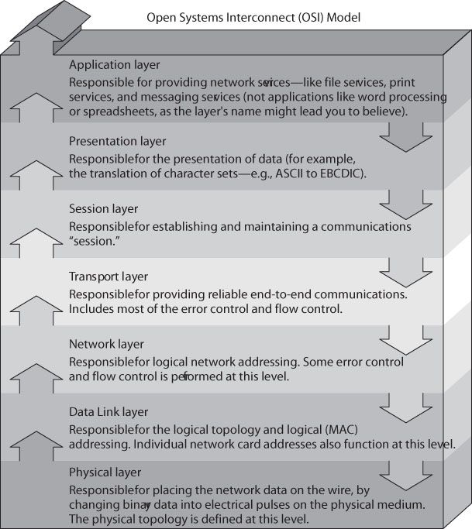
OSI Model
Notes:
Protocol – common language used by computers to communicate
Computers need standards to follow to keep their communication clear – like the
English language – grammar, sentence construction etc. makes everyone understand each other
OSI Model
The International Organization for Standardization (ISO) published the Open
Systems Interconnection (OSI) model in 1984 to provide a common way of describing network protocols. The ISO put together a seven-layer model providing a relationship between the stages of communication, with each layer adding to the layer above or
below it.
The higher layers pass data through the lower layers
Layers add Headers to the beginning of the message and Trailers at the end; these are removed at the receiver end leaving the original message
All People Seem To Need Data Processing
Application – Presentation – Session – Transport – Networking – Data Link - Physical

Slide 20
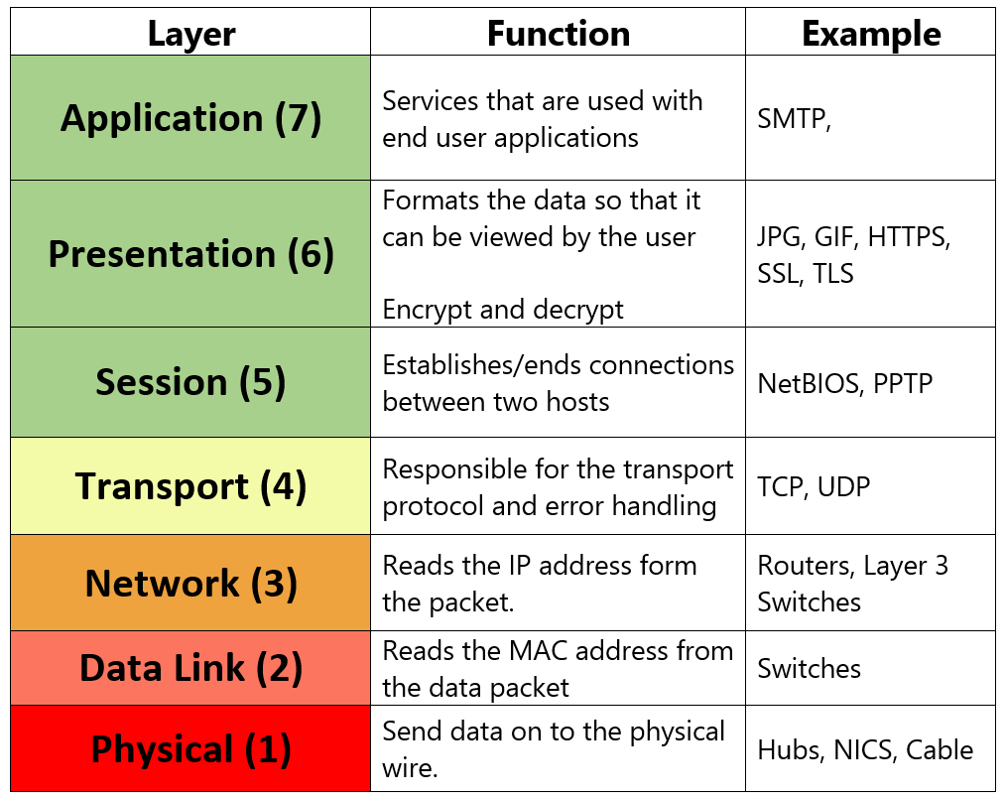
** The above examples will be discussed in detail in Chapter 7

Slide 21
Selected IEEE Standards
802.2 Logical Link Control (LLC)
802.3 CSMA/CD (Ethernet) LAN
802.5 Token Ring LAN
802.6 Metropolitan Area Network
802.11 Wireless Networking
Notes:
IEEE Standards The Institute of Electrical and Electronics Engineers (IEEE))
Set of rules that govern who communicates, when and how they do it
Standards for network types
They enhance the bottom 3 layers of the OSI model
802.2 Logical Link Layer
Specifies the interface between the Network Layer and the Data Link Layer
They divide the DATA LINK LAYER into 2: LLC and MAC
802.2 is the topmost sublayer of the DATA LINK LAYER
LLC – Logic Link Control - manage communication and access to 1 or more lower layer networks like 802.3 (Ethernet), 802.5 and 802.11. It works with MAC addresses to ensure
MAC – MAC addresses, Media Access Control, manages physical addresses and watches out for data collision
For example if you have a PC or Server with multiple NICs it ensures packets are sent to the proper NIC, therefore upper layer protocols don’t need to have specific knowledge of the lower layer networks in use

Slide 22
Selected IEEE Standards
802.2 Logical Link Control (LLC)
802.3 CSMA/CD (Ethernet) LAN
802.5 Token Ring LAN
802.6 Metropolitan Area Network
802.11 Wireless Networking
Notes:
802.3 (Ethernet) CSMA/CD
Carrier Sense Multiple Access with Collision Detection
Standard for how Ethernets operate
Original standard was 10Mbps (coaxial cable and Ethernet), the 100Mbps (Fast Ethernet), then 1000Mbps (Gigabit Ethernet) and 10Gigabit Ethernet
A packet can range from 72 bytes to 1518 bytes
Understanding CSMA/CD (Contention based access method)
Carrier Sense (CS) – Computers in the network are constantly listening to the wires i.e. sensing
Multiple Access (MA) – Multiple computers have access to the line at the same time
Collision Detection (CD) – When 2 computers talk at the same time a collision occurs and both computers wait, sending computer resends/retransmits. More than 100 computers(large networks), more collisions than transmissions occur

Slide 23
Selected IEEE Standards
802.2 Logical Link Control (LLC)
802.3 CSMA/CD (Ethernet) LAN
802.5 Token Ring LAN
802.6 Metropolitan Area Network
802.11 Wireless Networking
Notes:
802.5 (Token Ring)
Logical ring on a physical star topology
Token (or access packet) circulates the network and only computers with a token can send a message. Otherwise they wait.
802.6 (MAN)
Governs MANs
Improvement of FDDI (Fiber Distributed Data Interface) which failed due to high cost of implementation and lack of compatibility with LANs
802.11 (Wireless Networks)
The rules for communicating with all versions of 802.11 are defined by the IEEE standard such as the 802.11 a/b/g/n

Slide 24
Network Interface Cards
Compatibility
Performance
Sending and controlling data
Configuration
Drivers
Notes:
The network interface card (NIC), also referred to as a network adapter card, provides the physical interface between computer and cabling.
Evaluate NICs by:
Compatibility
Must fit the bus type of the PC. If PC and PCIe exist use the fastest bus i.e. PCIe
NIC Performance
If WIFI supports 802.11a/b/g/n get n the fastest
Sending and Controlling Data
Transmitting and Receiving NICS must agree on the following otherwise data fails to send
Maximum size of data frames
Amount of data sent before giving confirmation
Time needed between transmissions
Time to wait before sending confirmation
Speed to transmit data
Same access method/cable (Ethernet or token ring). Full duplex (can transmit and receive at the same time or half duplex (between sender and receiver only one can transmit at a time

Slide 25
Network Interface Cards
Compatibility
Performance
Sending and controlling data
Configuration
Drivers
Notes:
NIC Configuration
Unique MAC address to communicate – MACS hardwired to NICs by manufacturers
NIC Drivers
Drivers – Software that enables NICs to communicate with the Operating System
Must be installed

Slide 26
Cables and Connectors
Coaxial
Twisted Pair
Fiber
Notes:
Physical layer – bottom layer
When the data is passing through the OSI model and reaches the Physical layer, it must find its way onto the medium that is used to transfer data physically from computer to computer known as cable
For wireless networks the medium is air (Chapter 8)

Slide 27
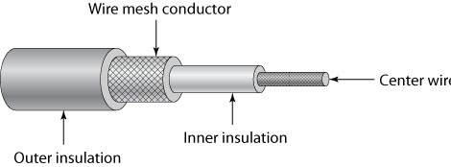
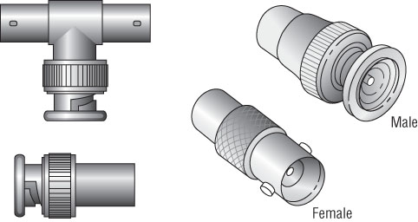
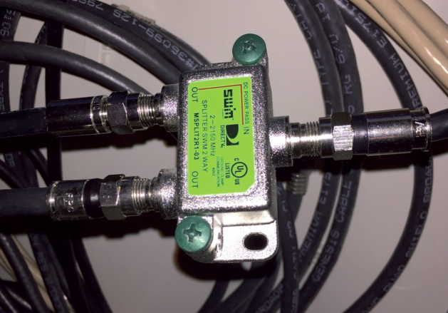
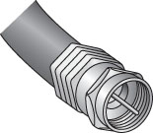
Coaxial Cable
Notes:
Center Wire made of copper
Also covered with PVC (Polyvinyl Chloride) – produces bad gas when burned hence
Plenum-rated coating now in use (expensive but now mandated as fire code)

Slide 28
Coaxial Cable Types
RG # | Popular Name | Ethernet Implementation | Type of Cable
RG-6 | Satellite/cable TV, cable modems | N/A | Solid copper
RG-8 | Thicknet | 10Base5 | Solid copper
RG-58 U | N/A | None | Solid copper
RG-58 AU | Thinnet | 10Base2 | Stranded copper
RG-59 | Cable television | N/A | Solid copper
Notes:
First 2 standards - RG-8 (Thicknet) and RG-58A/U (Thinnet)
500 meters and 185 meters respectively
RG-8 was for network backbones and RG 58A/U for conventional physical bus
Today:
RG-6 - thicker, 304 meters or 1000ft – Digital signals
RG-59 – analog cable TV (228 meters or 750 feet)
Thicknets used Vampire Taps to connect a computer to the cable – aka Piercing tap
Thinnet was much easier to use because they used BNC connectors
F Connector – Used with cable TV

Slide 29
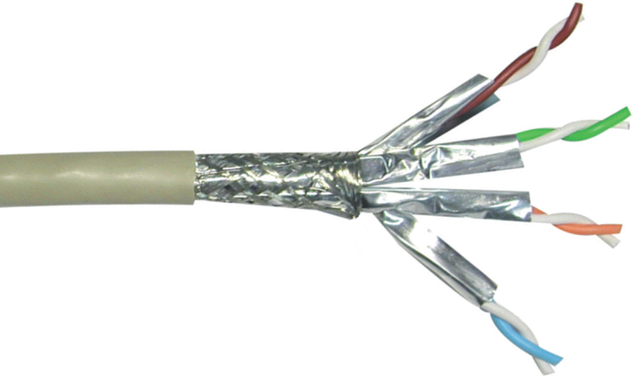
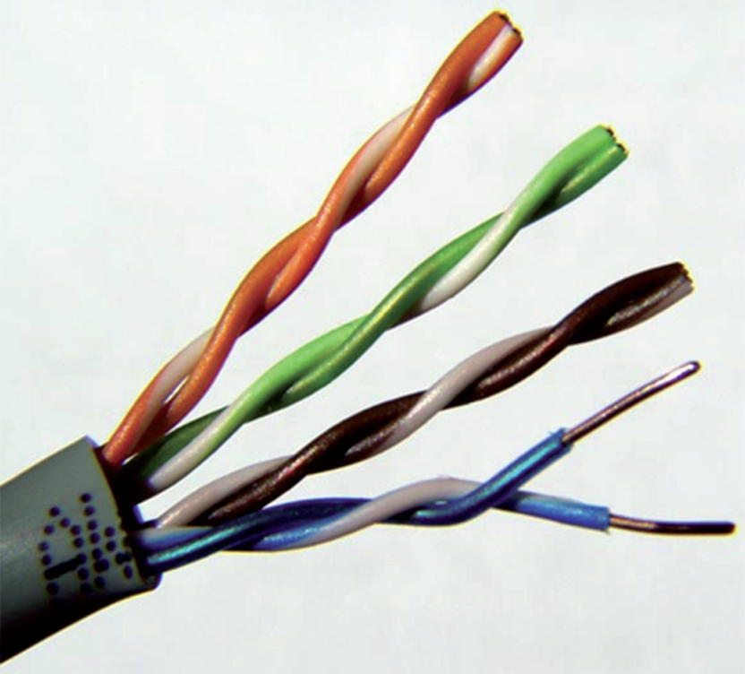
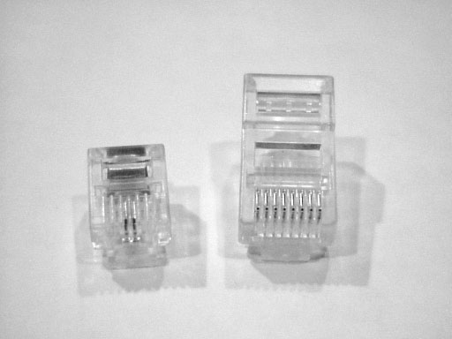
Twisted Pair Cable
Notes:
Most common (RJ-11 and RJ-45 are seen today)
2 types with 4 pairs of twisted wire
Shielded (STP) – has an extra layer of foil to decrease electrical interference
Unshielded (UTP) - Also has PVC or Plenum coating but no foil but
Twisted Pair Specifications
CAT1 – Only category with 2 twisted pairs for voice only transmissions – legacy phones
CAT2 – 4 pairs of wires, lowest grade, 4Mbps
CAT3 – 10Mbps
CAT4 - 16Mbps
CAT5 – 100Mbps
CAT5e – 1Gbps –more twists per foot added to CAT5
CAT6 – 10Gbps but up to 55 meters only. Lowest level to connect different networks like different floors
CAT6a – 10Gbps up to 100 meters
CAT7 – 10Gbps up to 100 meters - ** Every pair is shielded to reduce noise – AKA CATF

Slide 30
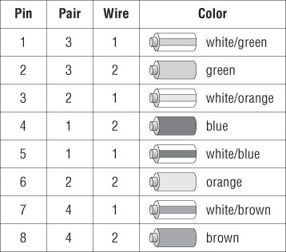
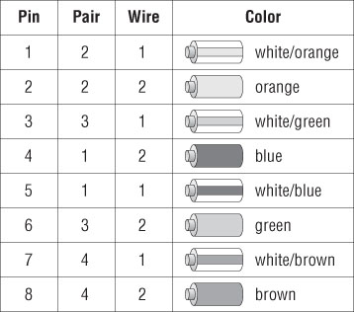
568A/B Standards
568 A
568 B
Notes:
The 2 standard ensure the 8 wires in a twisted pair are in the correct place
PC connections to hubs, switches – both sides have the same layout use 568A or 568B
PC connected directly to PC – use crossover cable – pin 1-3 and 2-6 are crossed over

Slide 31
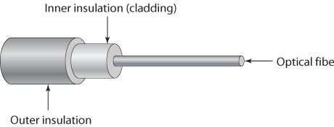
Fiber Optic Cable
Single-mode fiber (SMF)
Multi-mode fiber (MMF)
Notes:
Best advances in cabling
Thin flexible glass in rubberized coating
Uses pulses of light and not voltages to transmit data, therefore no electrical interference or wiretapping
Speeds from 100Mbps – to 10Gbps over several miles
High cost of installation makes it unfavorable for LANs
Specifications
Single Mode Fiber (SMF) -Single mode of light, does not bounce off the cable walls, supports lower bandwidth but over longer distances – 10Gbps over 40km or 25.85miles. Used as network backbone.
Multimode Fiber (MMF) – Permits multiple modes of light, they bounce back, deliver high bandwidth but over short distances – 10Gbps over 550 meters

Slide 32
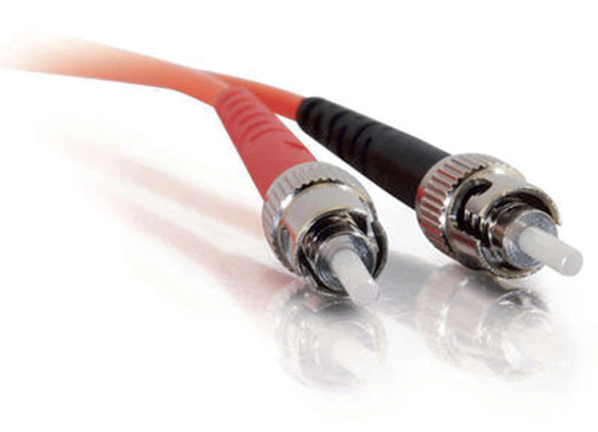
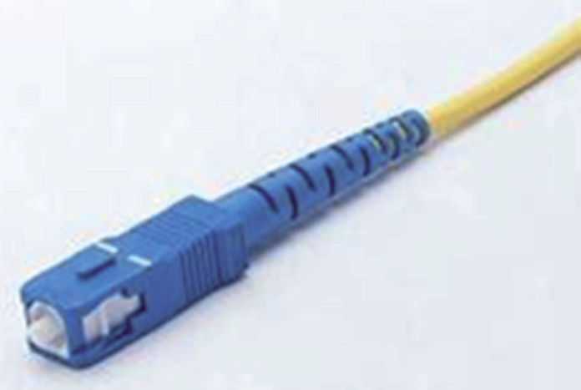
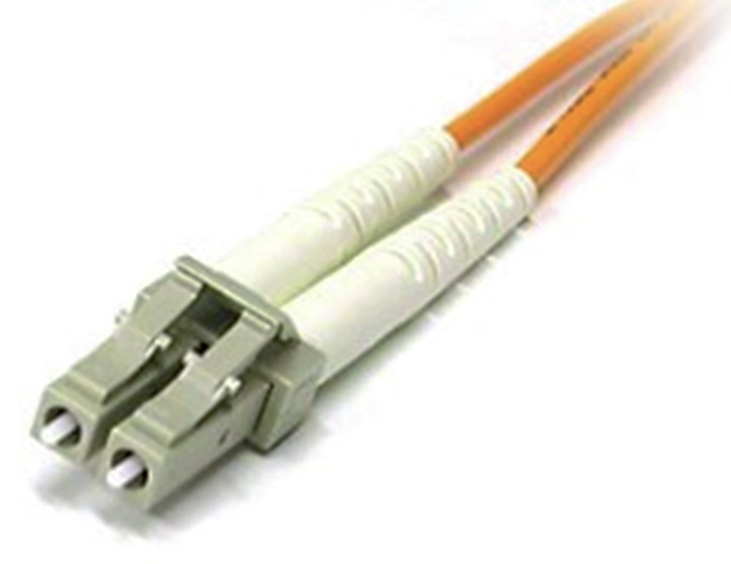
Fiber Optic Connectors
ST
SC
LC
Notes:
Several but the above three are the most common:
Straight tip – Easy to use, uses BNC attachment mechanism, most common
Subscriber connector – aka square connector, latch connection requires press button to release
Local Connector – Mini form factor, fast storage, and Gigabit Ethernet adapters
EXERCISE 6.1

Slide 33
Connectivity Devices
Modem
Access point
Repeater and extender
Hub
Notes:
In A+ Network components are classified into 2 broad categories:
Connectivity devices – Allow connectivity beyond LANs
Auxiliary devices – Add features outside of connectivity, firewall, POE etc.
Connectivity devices:
Modem – uses old phone lines, modulator, demodulator i.e. convert digital signals into analog for telephone wires – 56Kbps
Access Points – WAPS allow users to connect to your wireless network (802.11)
Repeater and Extender – Device that receives and amplifies a signal before resending it. Extend distance of cable
Hub – links several computers together. Simple with no intelligence. Broadcast signals from port to port. Passive hubs port connector with no power source while Active hubs use electronics to clean and amplify the source before broadcasting it (can be used as extenders)

Slide 34
Connectivity Devices (continued)
Patch panel
Bridge
Switch
Router
Notes:
Patch panel – like hub, no intelligence, only serves to connect cables
Bridge – Layer 2 Data Link Layer), Join multiple topologies, Isolate traffic from entering the wrong segment. More intelligent than repeaters. Disadv. They forward broadcast packets. Routers stop broadcasts
Switches – Layer 2 provide centralized connectivity but examine the packet header before forwarding it to the right port – improved performance!
Routers – Layer 3 Highly intelligent devices that connect multiple networks and determine the best path. Use Routing tables to store addresses
Advantages of Routers:
■■ They connect multiple networks to each other, which none of the other devices we have discussed do.
■■ Routers do not forward broadcasts. (Switches and bridges break up collision domains, whereas routers break up broadcast domains.)
■■ Routers are normally used to connect one LAN to another. Typically, when a WAN is set up, at least two routers are used.

Slide 35
Auxiliary Devices
Ethernet over Power
Power over Ethernet
Notes:
This group help protect the network from malicious attacks, providing network connections over power lines, and providing power over Ethernet cables
Firewall – Network security guard. Hardware or Software. Protect from hackers and prevent access to undesirable content by filtering packets based on rules.
Have a public side (connected to the internet) and a private side (internal network). Some have a 3rd network – DMZ that is both private and public e.g. email and web.
By default they are configured – default deny – all traffic blocked unless specified.
Access Control List (ACL) – is the set of rules that determine which packets are allowed and which packets are blocked.
Ethernet over Power – uses electrical cable to make data connections using an EOP adapter. Both devices connected must be on the same electric circuit
Power over Ethernet – Device is powered using RJ-45 cable run to it. The other end has an adaptor connected to power

